Slide 1


OBJECT ORIENTED PROGRAMMING THROUGH JAVA

Slide 2

L18-STRING
AND
STRING BUFFER CLASS

Slide 3


Slide 4
Strings:
In Java, string is basically an object that represents sequence of char values. An array of characters works same as Java string. For example:
char[] ch={'j','a','v','a','t','p','o','i','n','t'};
String s=new String(ch);
is same as:
String s="javatpoint";
Java String class provides a lot of methods to perform operations on strings such as compare(), concat(), equals(), split(), length(), replace(), compareTo(), intern(), substring() etc.
The java.lang.String class Implements Serializable, Comparable and CharSequence interfaces.

Slide 5
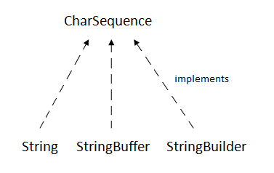
CharSequence Interface:-
The CharSequence interface is used to represent the sequence of characters. String, StringBuffer and StringBuilder classes implement it. It means, we can create strings in Java by using these three classes.
The Java String is immutable which means it cannot be changed. Whenever we change any string, a new instance is created. For mutable strings, you can use StringBuffer and StringBuilder classes.

Slide 6
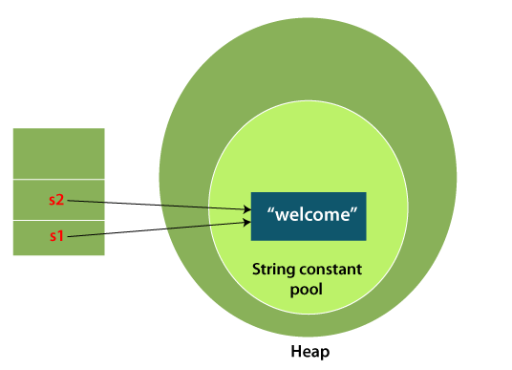
What is String in Java?:-
Generally, String is a sequence of characters. But in Java, string is an object that represents a sequence of characters. The java.lang.String class is used to create a string object.
How to create a string object?
There are two ways to create String object:
By string literal
By new keyword
1) String Literal:-
Java String literal is created by using double quotes. For Example:
String s="welcome";
Each time you create a string literal, the JVM checks the "string constant pool" first. If the string already exists in the pool, a reference to the pooled instance is returned. If the string doesn't exist in the pool, a new string instance is created and placed in the pool. For example:
String s1="Welcome";
String s2="Welcome";//It doesn't create a new instance

Slide 7
2) By new keyword
String s=new String("Welcome");//creates two objects and one reference variable
In such case, JVM will create a new string object in normal (non-pool) heap memory, and the literal "Welcome" will be placed in the string constant pool. The variable s will refer to the object in a heap (non-pool).
Java String Example
StringExample.java
public class StringExample{
public static void main(String args[]){
String s1="java";//creating string by Java string literal
char ch[]={'s','t','r','i','n','g','s'};
String s2=new String(ch);//converting char array to string
String s3=new String("example");//creating Java string by new keyword
System.out.println(s1);
System.out.println(s2);
System.out.println(s3);
}}

Slide 8

Strings are immutable in java
In Java, String is a final and immutable class, which makes the most special.
String class cannot be inherited, and once created, we can not alter the object. This nature is called immutability.
  Ex:
  String s=“Hello";
  s.concat(“Good morning");
  System.out.println(s);
String object is one of the most-used objects in any of the programs.

Slide 9
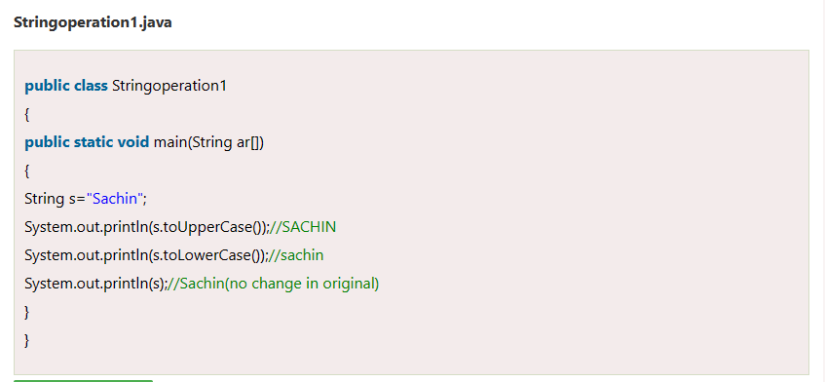
Java String Class Methods:-
The java.lang.String class provides a lot of built-in methods that are used to manipulate string in Java. By the help of these methods, we can perform operations on String objects such as trimming, concatenating, converting, comparing, replacing strings etc.
Java String is a powerful concept because everything is treated as a String if you submit any form in window based, web based or mobile application.
Java String toUpperCase() and toLowerCase() method:-
The Java String toUpperCase() method converts this String into uppercase letter and String toLowerCase() method into lowercase letter.

Slide 10
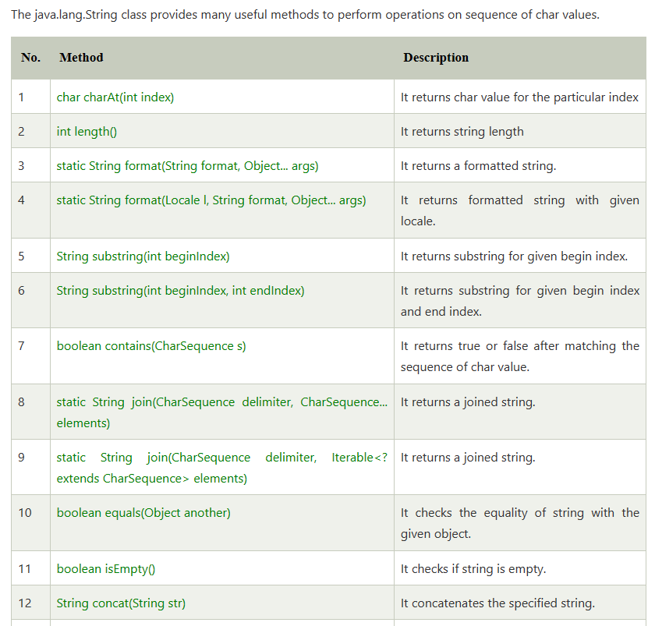
Java String class methods

Slide 11
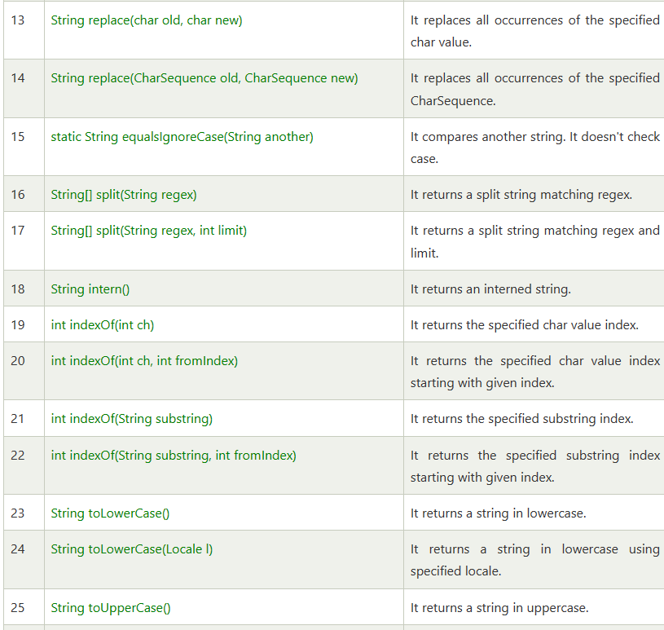

Slide 12
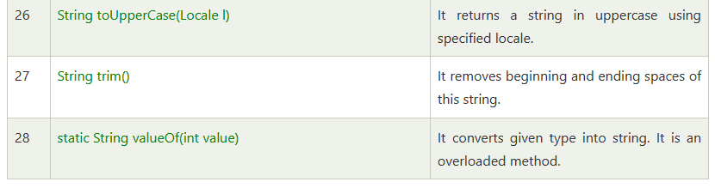

Slide 13
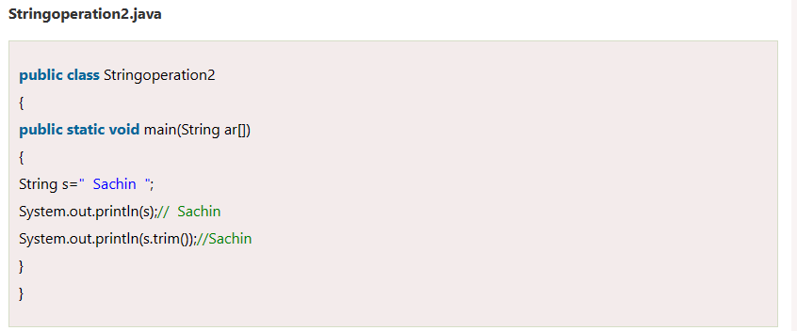
Java String trim() method:-
The String class trim() method eliminates white spaces before and after the String.

Slide 14
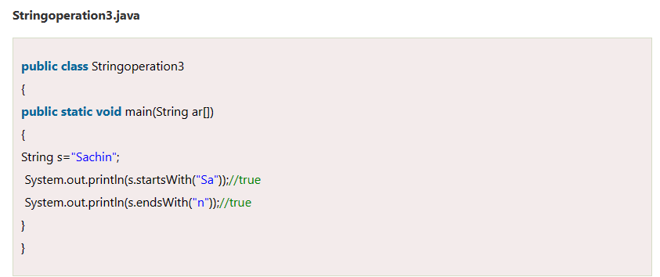
Java String startsWith() and endsWith() method:-
The method startsWith() checks whether the String starts with the letters passed as arguments and endsWith() method checks whether the String ends with the letters passed as arguments.

Slide 15
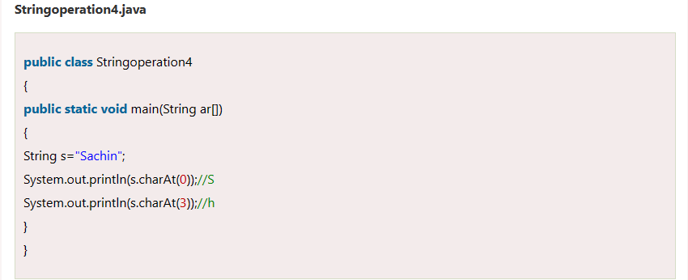
Java String charAt() Method:-
The String class charAt() method returns a character at specified index.

Slide 16
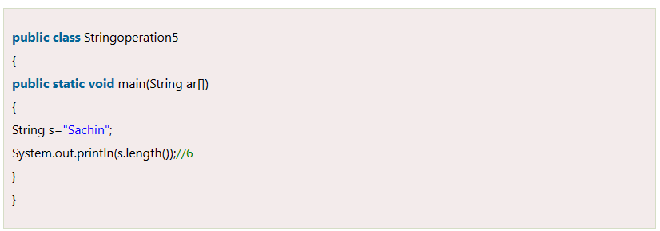
Java String length() Method:-
The String class length() method returns length of the specified String.

Slide 17
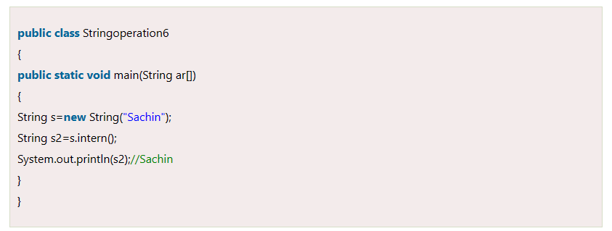
Java String intern() Method:-
A pool of strings, initially empty, is maintained privately by the class String.
When the intern method is invoked, if the pool already contains a String equal to this String object as determined by the equals(Object) method, then the String from the pool is returned. Otherwise, this String object is added to the pool and a reference to this String object is returned.

Slide 18
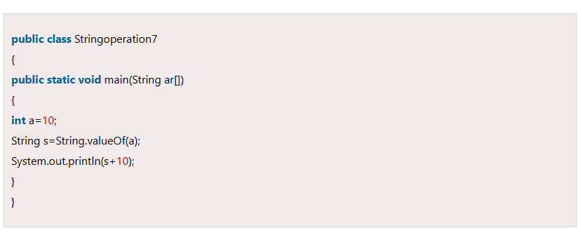
Java String valueOf() Method:-
The String class valueOf() method coverts given type such as int, long, float, double, boolean, char and char array into String.

Slide 19
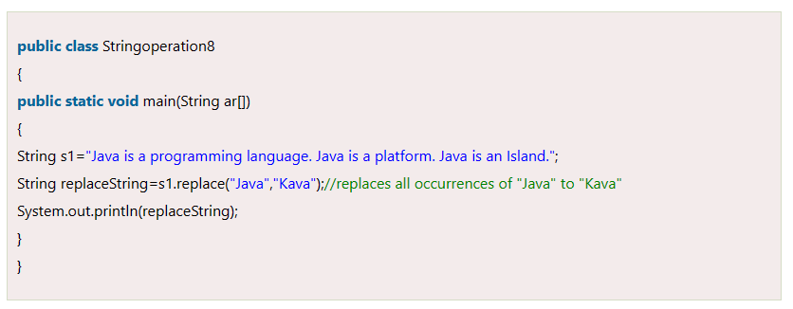
Java String replace() Method:-
The String class replace() method replaces all occurrence of first sequence of character with second sequence of character.

Slide 20
concat() :
This method returns a String with the value of the String passed in to the method appended to the end of the String used to invoke the method.
Example:
String x = “Java";
System.out.println( x.concat(“ Programming") );

Slide 21
The overloaded + and += operators perform functions similar to the concat() method
Example:
  String x = “Java";
  System.out.println( x + " coding");// output is Java coding
  String x = “1234";
  x+= “56789";
  System.out.println( x ); // output is 123456789

Slide 22
equalsIgnoreCase() :
This method will ignore the case of the String and It returns a boolean value (true or false).
Ex:
  String x = “Java";
  System.out.println( x.equalsIgnoreCase(“java"));/ is true
  System.out.println( x.equalsIgnoreCase(“Javaa")); // is false

Slide 23
replace() :
This method will replace with char in the first argument by the char in the second argument.
Ex:
String x = "oxoxoxox";
System.out.println( x.replace('x', 'X') ); // output is oXoXoXoX

Slide 24
substring():
As name suggest it will return substring of given String.
Two constructors:
  public String substring(int begin)
  public String substring(int begin, int end)
  EX:
  String x = "0123456789";
  System.out.println( x.substring(5) ); // output is 56789
  System.out.println( x.substring(5, 8)); //output is 567

Slide 25
STRING BUFFER CLASS:-
Java StringBuffer class is used to create mutable (modifiable) String objects. The StringBuffer class in Java is same as String class except it is mutable i.e. it can be changed.
Java StringBuffer Constructors
1. Empty StringBuffer
This constructor creates an empty string buffer
StringBuffer str = new StringBuffer();
2. Argument StringBuffer:
This constructor creates a string buffer with a size defined in the argument.
StringBuffer str = new StringBuffer(int size); // it takes an argument in integer.
StringBuffer str = new StringBuffer(20);

Slide 26
3. String StringBuffer in Java:-
This constructor declares a set of an initial string with 15 characters in a reserved space without reallocation.
StringBuffer str= new StringBuffer(String str); // it takes string as arguments.
StringBuffer str = new StringBuffer(“JAVAPROGRAMMING”);
Java StringBuffer Methods:-
Methods in Java are the collection of predefined expressions that executes some sort of task when we explicitly call them. Generally to call any of the methods we just execute:
ReferenceVariable.MethodName(parameters)

Slide 27
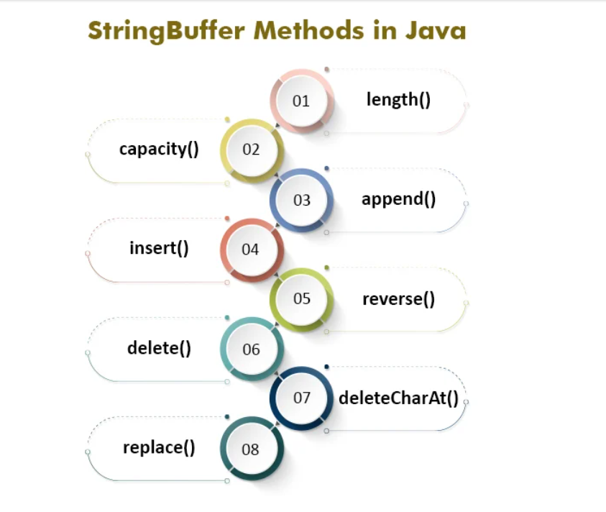

Slide 28
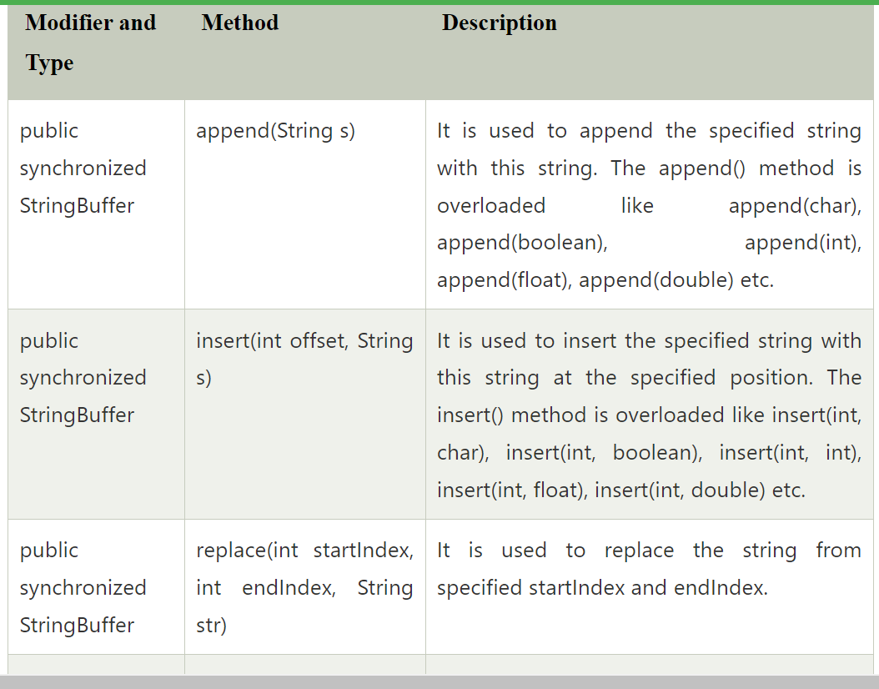

Slide 29
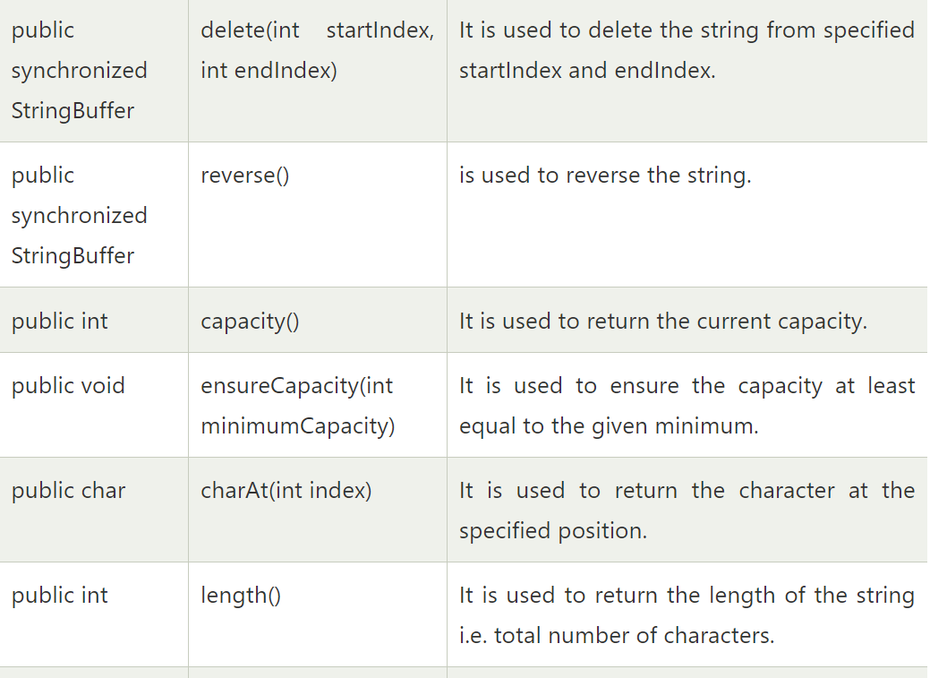

Slide 30
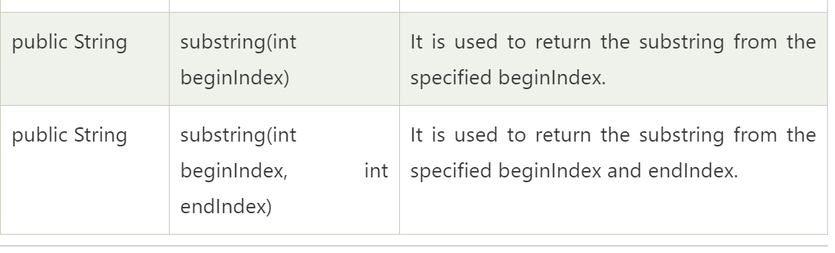
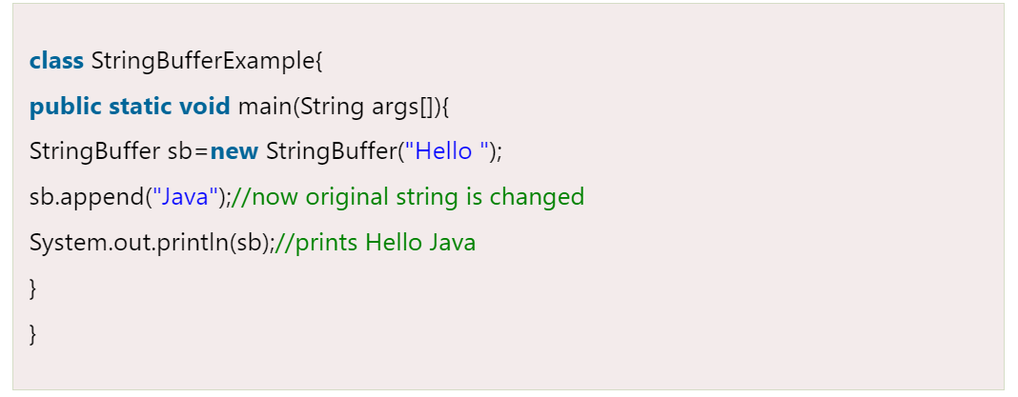
1.StringBuffer Class append() Method:-
The append() method concatenates the given argument with this String.

Slide 31
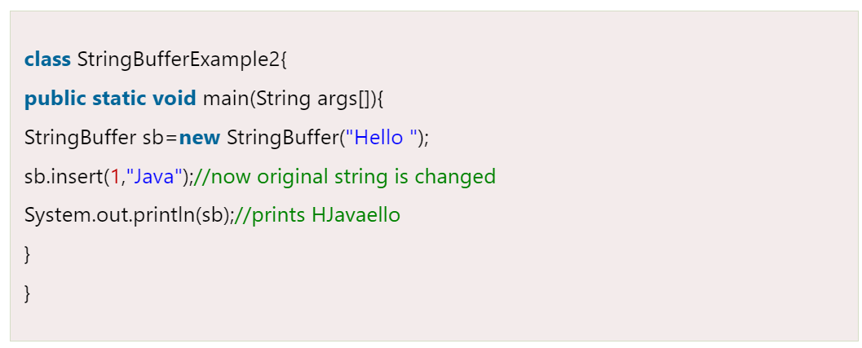
2) StringBuffer insert() Method:-
The insert() method inserts the given String with this string at the given position.

Slide 32
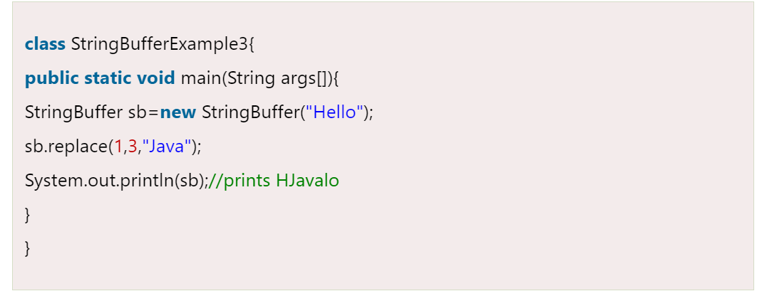
3) StringBuffer replace() Method:-
The replace() method replaces the given String from the specified beginIndex and endIndex.

Slide 33
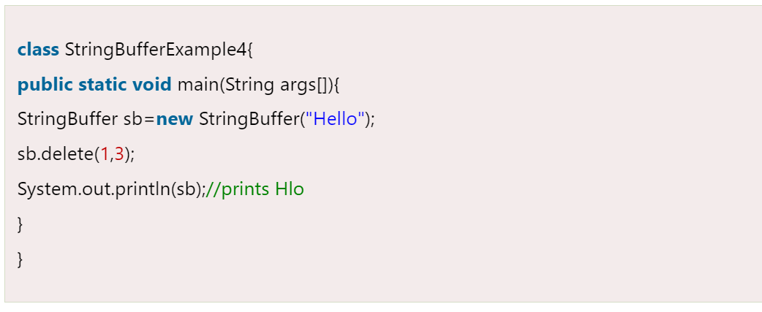
4) StringBuffer delete() Method:-
The delete() method of the StringBuffer class deletes the String from the specified beginIndex to endIndex.

Slide 34
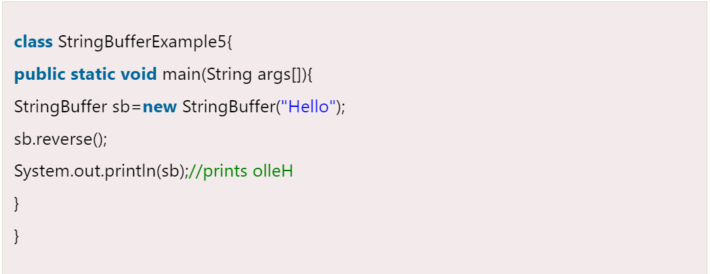
5) StringBuffer reverse() Method:-
The reverse() method of the StringBuilder class reverses the current String.

Slide 35
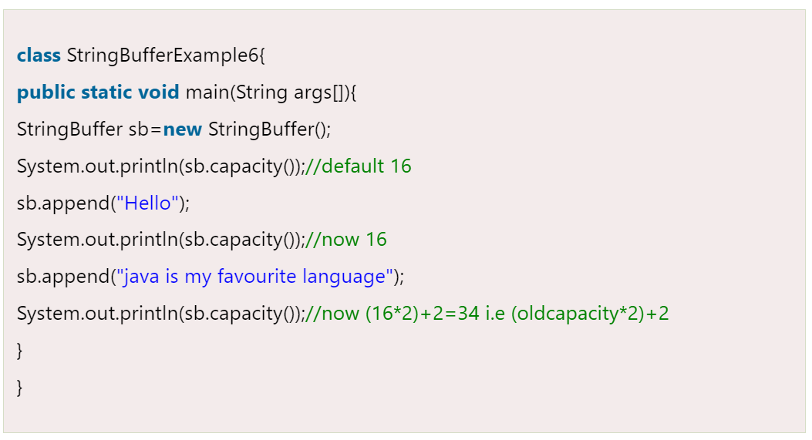
7) StringBuffer capacity() Method:-
The capacity() method of the StringBuffer class returns the current capacity of the buffer. The default capacity of the buffer is 16. If the number of character increases from its current capacity, it increases the capacity by (oldcapacity*2)+2. For example if your current capacity is 16, it will be (16*2)+2=34.

Slide 36
8. StringBuffer deleteCharAt():-
The deleteCharAt() method deletes only the character at the specified index.
We provide the index number as the argument of the method and it deletes the character present at that index and returns the resulting string after deleting that specific character.
Syntax:
stringName.deleteCharAt(int index)

Slide 37
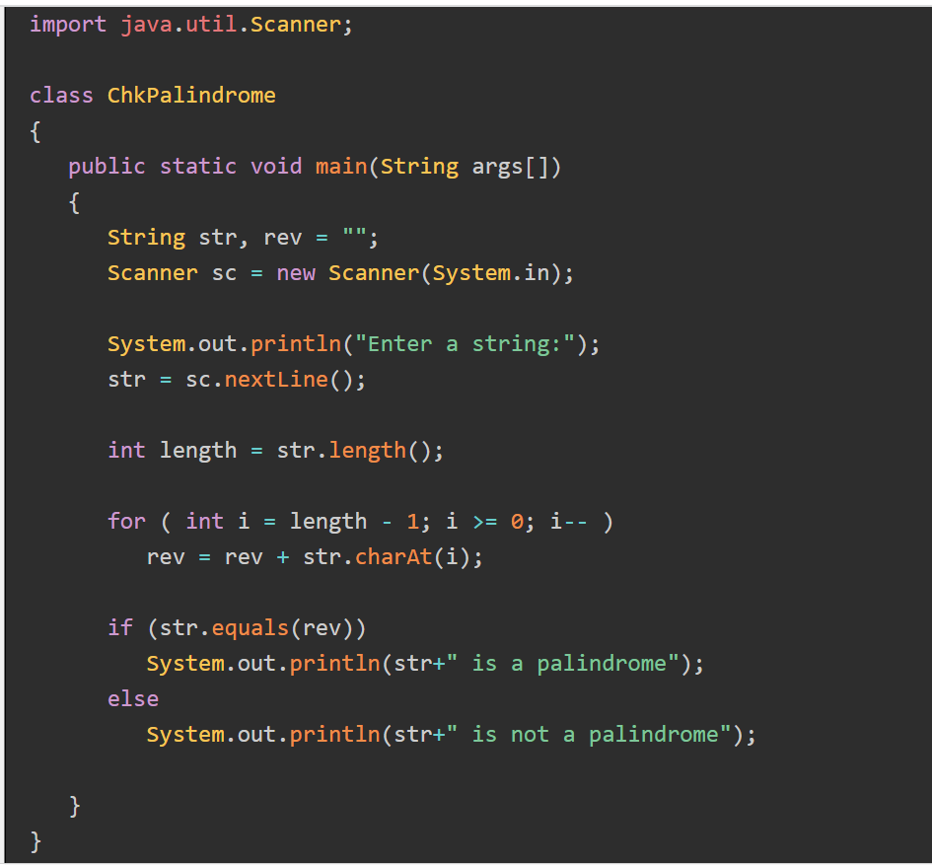

Slide 38
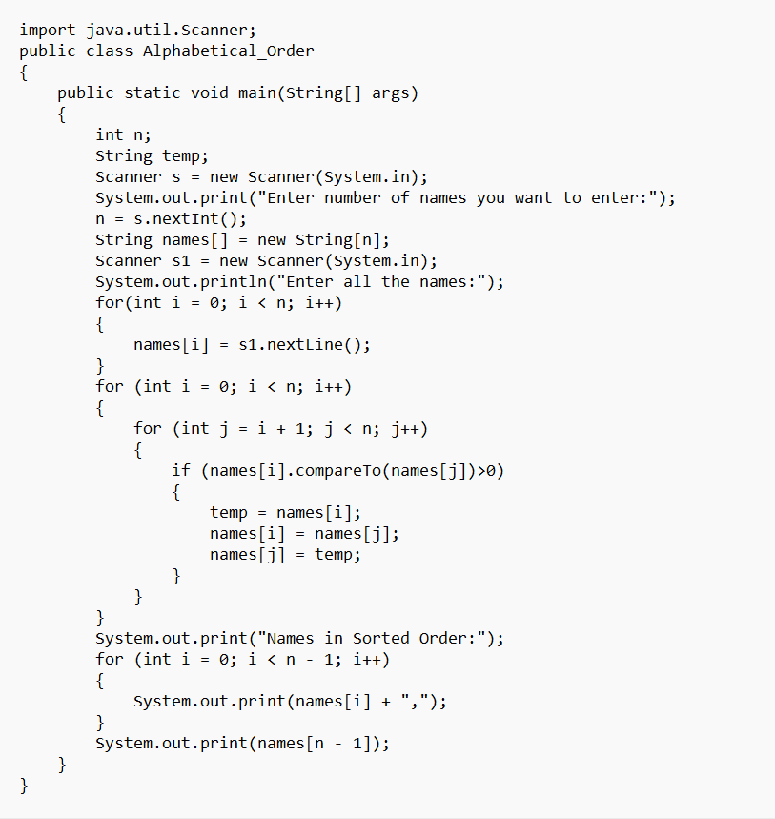

Slide 39
Next….
SIMPLE JAVA PROGRAM
Notes:
In Slide Show mode, click the arrow to enter the PowerPoint Getting Started Center.

Slide 40



